Slide 1

Internet Coast v1.0
Team Member(s): Ariel E. Novo Product Owner(s): Dale Gregory Mentor: Mohsen Taheri
Instructor: Masoud Sadjadi School of Computing and Information Sciences Florida International University
Final Presentation
Fall 2016
Notes:
7 seconds.
Greet your audience, thank them for attending your presentation, introduce yourself, introduce your project, introduce your team members, and quickly indicate what each of you did in a high-level manner, and put more emphasis on your part/contribution.

Slide 2
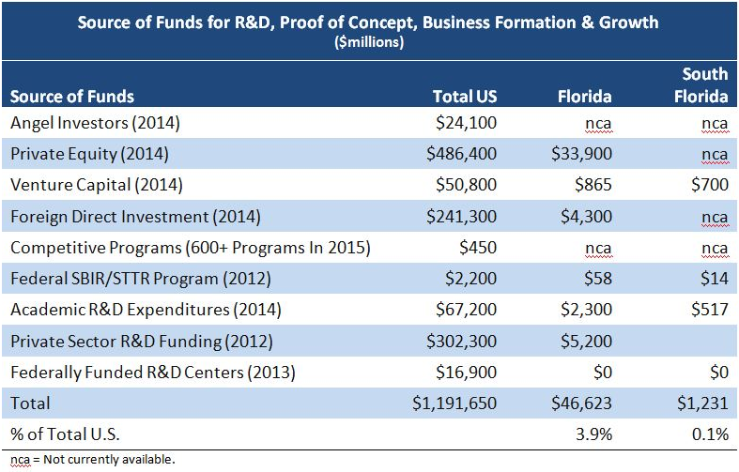
Project definition
Raising capital for startup is challenging and time consuming. Early stage funding sources include founders cash and debt, friends and family.... with angel and venture capital being extremely difficult to obtain.
Notes:
10 seconds.
Introduce the problem that the whole project (in all versions) tackles with GIF or screenshot.

Slide 3
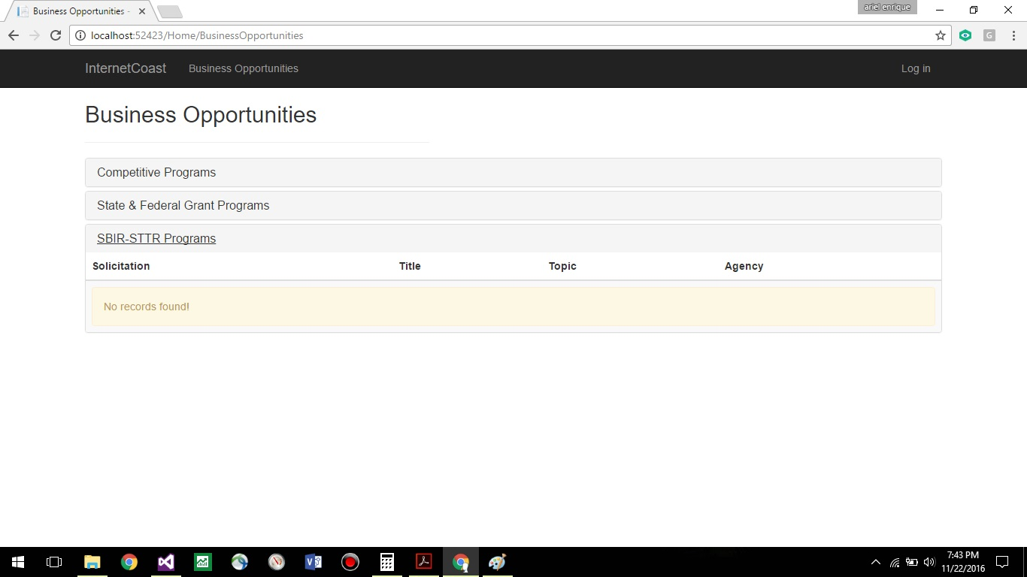
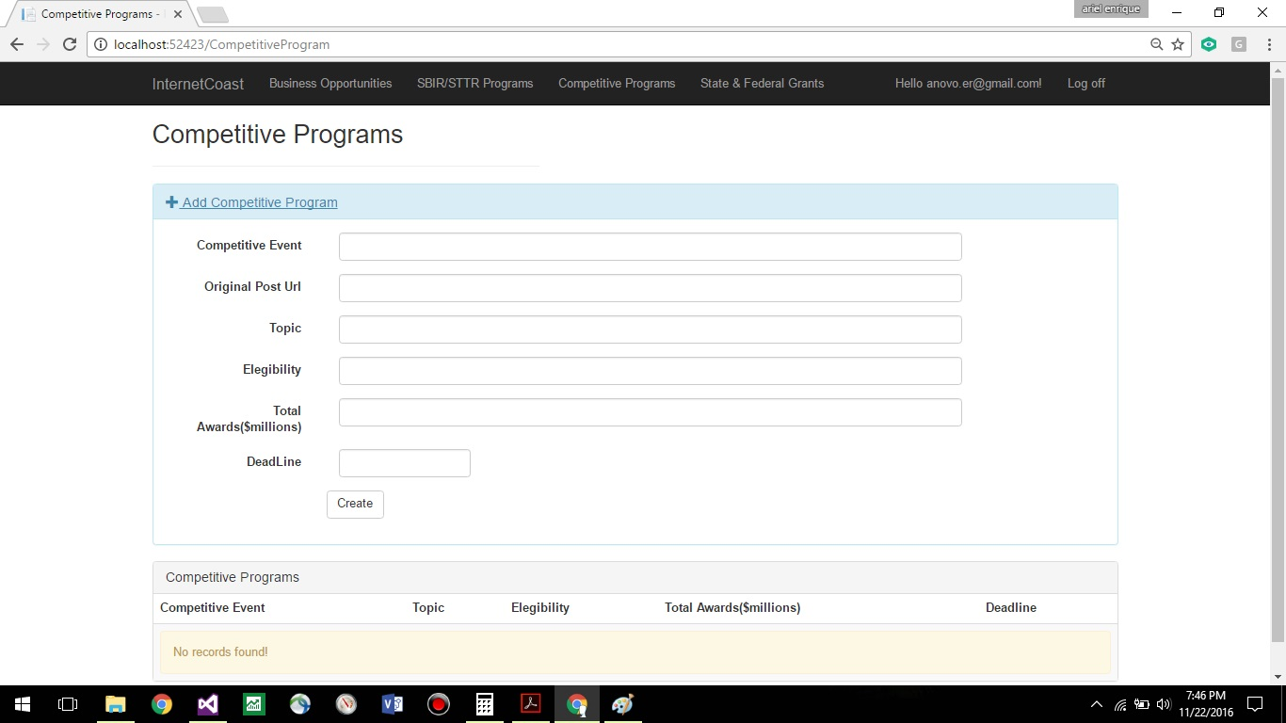
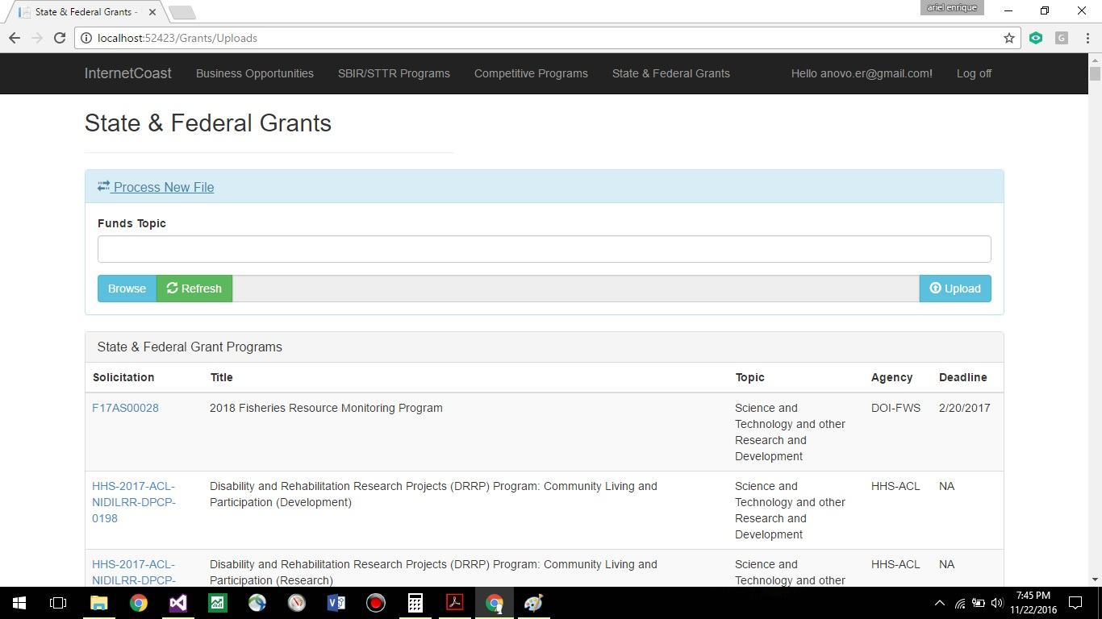
Project definition
Notes:
20 seconds.
Introduce the problem that the your project (in new version) tackles with GIF or screenshot.

Slide 4
Requirements: Use Cases
Notes:
5 seconds
Show the Use Case Diagram for the whole project. Highlight your use cases.

Slide 5
System Design: Architecture
Notes:
20 seconds
System design: Highlight the parts that you contributed to them.
1. System decomposition; identify the architecture patterns used
2. System deployment – h/w and s/w requirements

Slide 6
Minimal Class Diagram
Notes:
10 seconds.Minimal class diagram. Highlight the classes that you created/modified
Identify the design patterns used (one or more slides).

Slide 7
User Stories
#120 Create InternetCoast Data Base
#121: Create DOD reader component
#124: List of Funds
#123: Add competitive Programs
#133: Add State & Federal Grants
#138: Admin Login
Notes:
5 seconds.
List the user stories that you worked on them.(put in order of importance). Stay focused on the parts that you have been working.

Slide 8
User Story #120
Create InternetCoast Data Base.
As a system administrator store the information from all the grant sources in a standardized way that will facilitate the process of adding new funds opportunities to the system and also will allow the users to perform quick searches by topics of interest.
Acceptance Criteria:
A first version of the database is created.
Data can be inserted, modified and requested from and to the db.
Notes:
60 seconds
The tile of user story
The most important user story you worked on it. You have to describe this one very well and be proud of that.
Please present and show the complexity of your work, code, algorithms, and technical challenges and technologies you have used. (you could use screenshot if you want. Visual presentations are better than text presentation)
Go into the details of the most important/significant tasks using bullet lists or visual graphs or state chart diagram
Sequence Diagram for this user story is mandatory (in another separate page if required)
Demo using screenshots or GIF (in another separate page if required)

Slide 9
User Story #121
Create DOD reader component.
As a system administrator I need to automate the process of reading from the Department Of Defense SBIR grants and insert that information into the system.
Acceptance Criteria:
Been able to automatically read the information from the source.
Been able to automatically save the information into the system.
Notes:
60 seconds
The tile of user story
The most important user story you worked on it. You have to describe this one very well and be proud of that.
Please present and show the complexity of your work, code, algorithms, and technical challenges and technologies you have used. (you could use screenshot if you want. Visual presentations are better than text presentation)
Go into the details of the most important/significant tasks using bullet lists or visual graphs or state chart diagram
Sequence Diagram for this user story is mandatory (in another separate page if required)
Demo using screenshots or GIF (in another separate page if required)

Slide 10
User Story #124
List of Funds.
As a user of the system i want a list of funds so i can see all the current opportunities.
Acceptance Criteria:
Different types of funds are displayed in the list.
A link to the original posting is available for every item in the list.
Notes:
60 seconds
The tile of user story
The most important user story you worked on it. You have to describe this one very well and be proud of that.
Please present and show the complexity of your work, code, algorithms, and technical challenges and technologies you have used. (you could use screenshot if you want. Visual presentations are better than text presentation)
Go into the details of the most important/significant tasks using bullet lists or visual graphs or state chart diagram
Sequence Diagram for this user story is mandatory (in another separate page if required)
Demo using screenshots or GIF (in another separate page if required)

Slide 11
User Story #123
Add Competitive Program.
As a system administrator I need to add Competitive Programs into the system. These Programs are another source of funding opportunities. Once the information is recorded then it will be available to the users in the founds list.
Acceptance Criteria:
The information is captured accordingly.
Notes:
60 seconds
The tile of user story
The most important user story you worked on it. You have to describe this one very well and be proud of that.
Please present and show the complexity of your work, code, algorithms, and technical challenges and technologies you have used. (you could use screenshot if you want. Visual presentations are better than text presentation)
Go into the details of the most important/significant tasks using bullet lists or visual graphs or state chart diagram
Sequence Diagram for this user story is mandatory (in another separate page if required)
Demo using screenshots or GIF (in another separate page if required)

Slide 12
User Story #133
Add State & Federal Grants.
As an administrator of the system i would like to add State & Federal Grants to the system. These are another source of funding opportunities. Once the information is recorded then it will be available to the users in the founds list.
Acceptance Criteria:
No duplicates should be entered.
After information is entered, should be available in the list of funds immediately
Notes:
60 seconds
The tile of user story
The most important user story you worked on it. You have to describe this one very well and be proud of that.
Please present and show the complexity of your work, code, algorithms, and technical challenges and technologies you have used. (you could use screenshot if you want. Visual presentations are better than text presentation)
Go into the details of the most important/significant tasks using bullet lists or visual graphs or state chart diagram
Sequence Diagram for this user story is mandatory (in another separate page if required)
Demo using screenshots or GIF (in another separate page if required)

Slide 13
User Story #138
Admin Login.
As an admin of the system i want to login so that i can manage the content of the site.
Acceptance Criteria:
Admin menu should be available after login.
Notes:
60 seconds
The tile of user story
The most important user story you worked on it. You have to describe this one very well and be proud of that.
Please present and show the complexity of your work, code, algorithms, and technical challenges and technologies you have used. (you could use screenshot if you want. Visual presentations are better than text presentation)
Go into the details of the most important/significant tasks using bullet lists or visual graphs or state chart diagram
Sequence Diagram for this user story is mandatory (in another separate page if required)
Demo using screenshots or GIF (in another separate page if required)

Slide 14







Summary
Internet Coast 1.0 is a project that just started during the fall semester 2016. There is a great potential to continue working on this solution and plenty of room for improvement and innovation
Contact me at anovo018@fiu.edu
Questions?
Thank You!
Notes:
10 seconds
Summarize your contribution, mention your effort for Scrum, Mingle, Github, Google Drive Documentation and minutes
Include your contact information
Ask if anyone has any questions for you.
Thank your audience

